Slide 1
Assessment 1
Part B

Slide 2
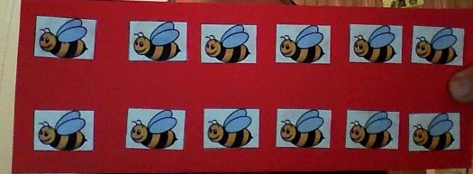
How many bees do we have in the top row?
That is correct we have 6. Let’s count them 1,2,3,4,5,6.
How many do we have in the next row? Without counting we can tell we have 6.
How many bees altogether, we have 1,2,3,4,5,6,7,8,9,10,11,12. So 2 x 6 = 12

Slide 3
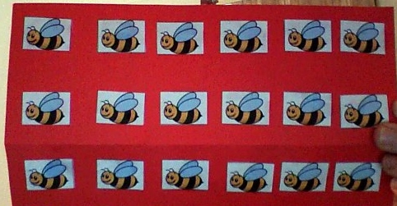
We counted 12 bees before, now how many more have we got now, yes we have got 6 more bees. That makes how many altogether, we have already counted up to twelve so we will continue from there 13,14,15,16,17,18. Yes we have 18 altogether. So we can say 6 by 3 equals 18.

Slide 4
We have 18 bees how many would we have in each group if we divided the bees into three groups. Another way we could say this is 18 divided by 3 equals what.

Slide 5
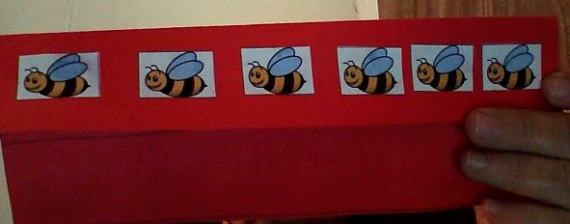
That is correct 6.

